Slide 1

Methods and challenges in timing chromosomal abnormalities
within cancer samples
分享人: 林丹
时间：20180726

Slide 2
INTRODUCTION
Motivation:
Tumors acquire many chromosomal amplifications, and those acquired early in the lifespan of the tumor may be not only important for tumor growth but also can be used for diagnostic purposes.
Results:
The model for timing chromosomal amplifications is limited in scope, particularly for regions with high levels of amplification.
The estimation of the order of events can be sensitive for events that occur early in the progression of the tumor and that the partial maximum likelihood method can give biased estimates, particularly for moderate read coverage or normal contamination.
We propose:
a maximum-likelihood estimation procedure that fully accounts for
sequencing variability and show that it outperforms the partial maximum-likelihood estimation method.
a Bayesian estimation procedure that stabilizes the estimates in certain settings.
We implement these methods on a small number of ovarian tumors, and the results suggest possible differences in how the tumors acquired amplifications.
Notes:
肿瘤早期获得的拷贝数扩增事件，不仅对研究肿瘤增殖有重要意义，对临床诊断也有重要意义。

Slide 3
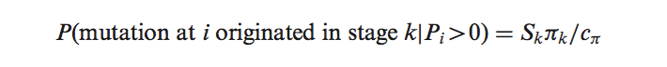
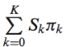
分析原理
理论假设：
1. 每个突变i历史上只发生过一次
2. 如果一个突变i发生在k阶段，那么它发生在k阶段每个拷贝上的概率(可能性)是相同的
3. 一个突变i发生在k阶段的概率假设与k阶段存在的时间(πk)以及k阶段存在的拷贝数(Sk)正相关。
Sk: k阶段的拷贝数
πk: k阶段的时间跨度（时长占比）
C π :
i : 突变位点 Pi : 突变位点i的等位基因频率

Slide 4
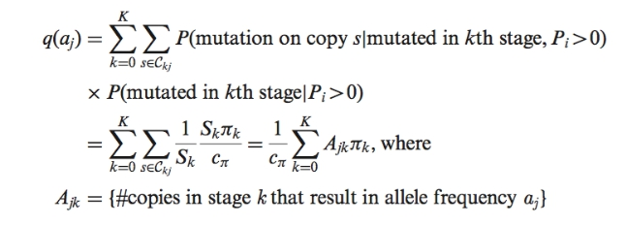
分析原理
q(aj): 等位频率aj发生的概率
Ckj: k阶段导致突变频率是aj的拷贝数

Slide 5
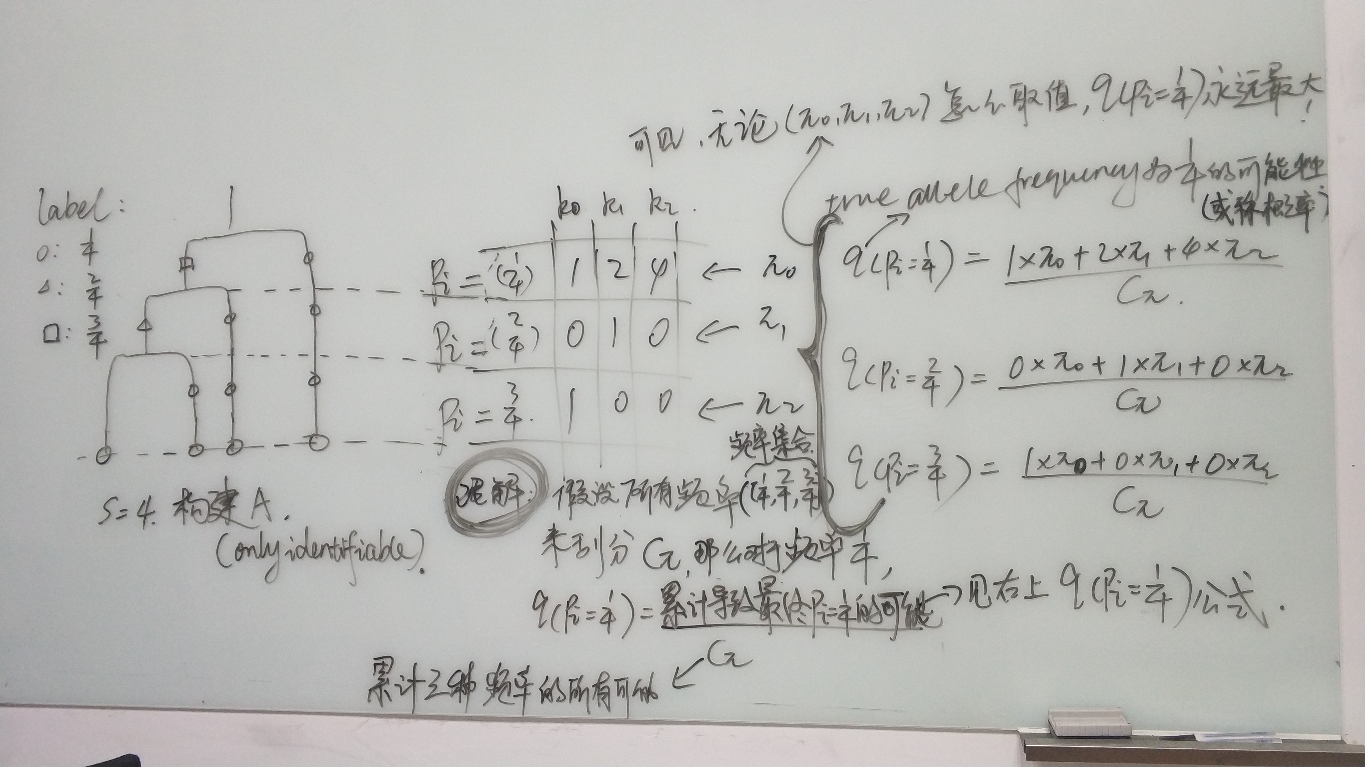
分析原理

Slide 6
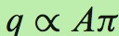
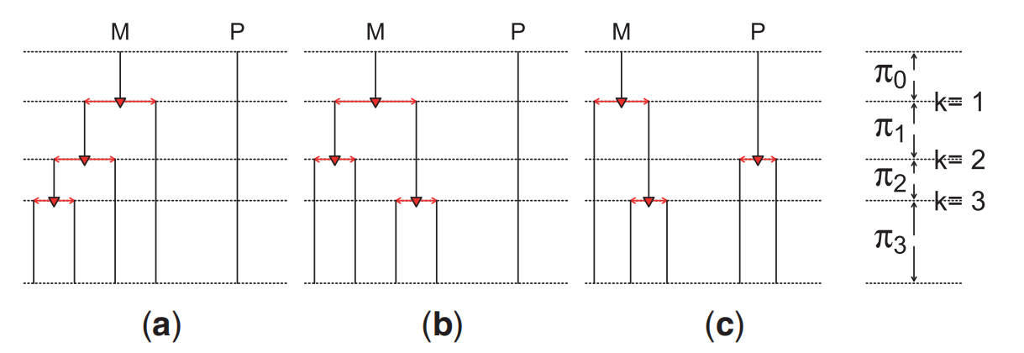
分析原理
A矩阵构建：S > 4 (S=5为例)
Example of three histories of amplification that can lead to copy number S=5

Slide 7
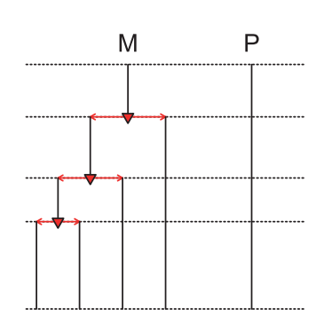
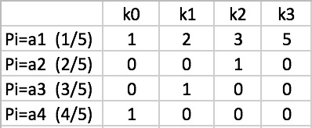
分析原理
A矩阵构建：S > 4 (S=5为例)
Only (a) is identifiable because all amplification occurs on one lineage

Slide 8
分析原理
A矩阵构建：S < 5
CNLOH: (0, 2)
single gain: (1, 2)
double gain: (1, 3)

Slide 9
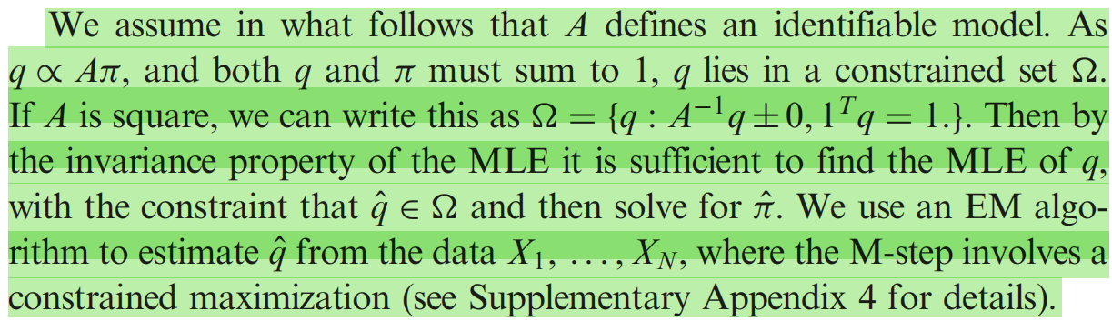
分析原理
model Xi，固定A，估算q，进而估算π
q的推断 : EM算法
π的推断：π0：贝叶斯估计
Directly taking into account the variability in the Xi by modeling the distribution of Xi.

Slide 10
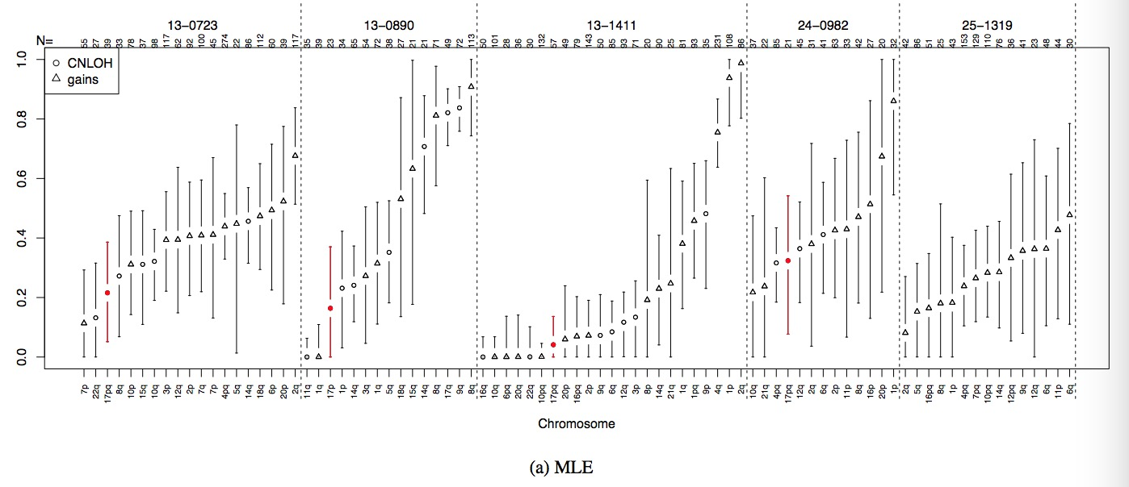
案例
CNLOH events involving the region containing TP53 are present in four of the five ovarian samples, and TP53 mutations are found in all four of these regions. Three of these TP53 mutations clearly occurred before the CNLOH
cancerTiming（eventTiming函数）只有输出每个位点的q，不支持每个突变位点的 π 的计算。CNLOH区域TP53突变发生在π 0还是π 1，可以根据TP53位点是纯合突变还是杂合突变进行推断，如果是纯合突变（即等位频率为2/2，理论上q(2/2)比较大），可以推断TP53突变发生在π 0阶段，如果是杂合突变（即等位频率为1/2，理论上q(1/2)比较大），可以推断TP53突变发生在π 1阶段。
The five tumors present dif- ferent general profiles. Two tumors (13-0890 and 13-1411) have events that are clearly separated through time and span the range of (relative) time, whereas events from other three tumors are estimated to have occurred over a small range of time, suggesting a short duration of rapid copy-number change. This suggests the possibility of two different biological mechanisms in use, with some tumors starting with a whole-genome duplication whereas other tumors steadily accumulate copy-number changes.
Notes:
Fig. S15. Estimates of π0 with 95% bootstrap confidence intervals for all ovarian samples. The full MLE (a), partial MLE (b) and Bayesian estimates (c) with their corresponding confidence intervals are shown for each sample. Regions of CNLOH are marked with a circle, those from a single gain are marked with a triangle. Regions from different samples are separated by dashed lines. The CNLOH of 17p is shown in red. Above each region, the number of mutations (N) identified in the region is indicated.
The large number of aberrations present in ovarian tumors allows us to observe the general trajectory of chromosomal amp- lifications (Supplemental Fig. S15). The five tumors present dif- ferent general profiles. Two tumors (13-0890 and 13-1411) have events that are clearly separated through time and span the range of (relative) time, whereas events from other three tumors are estimated to have occurred over a small range of time, suggesting a short duration of rapid copy-number change. This suggests the possibility of two different biological mechanisms in use, with some tumors starting with a whole-genome duplication whereas other tumors steadily accumulate copy-number changes.

Slide 11
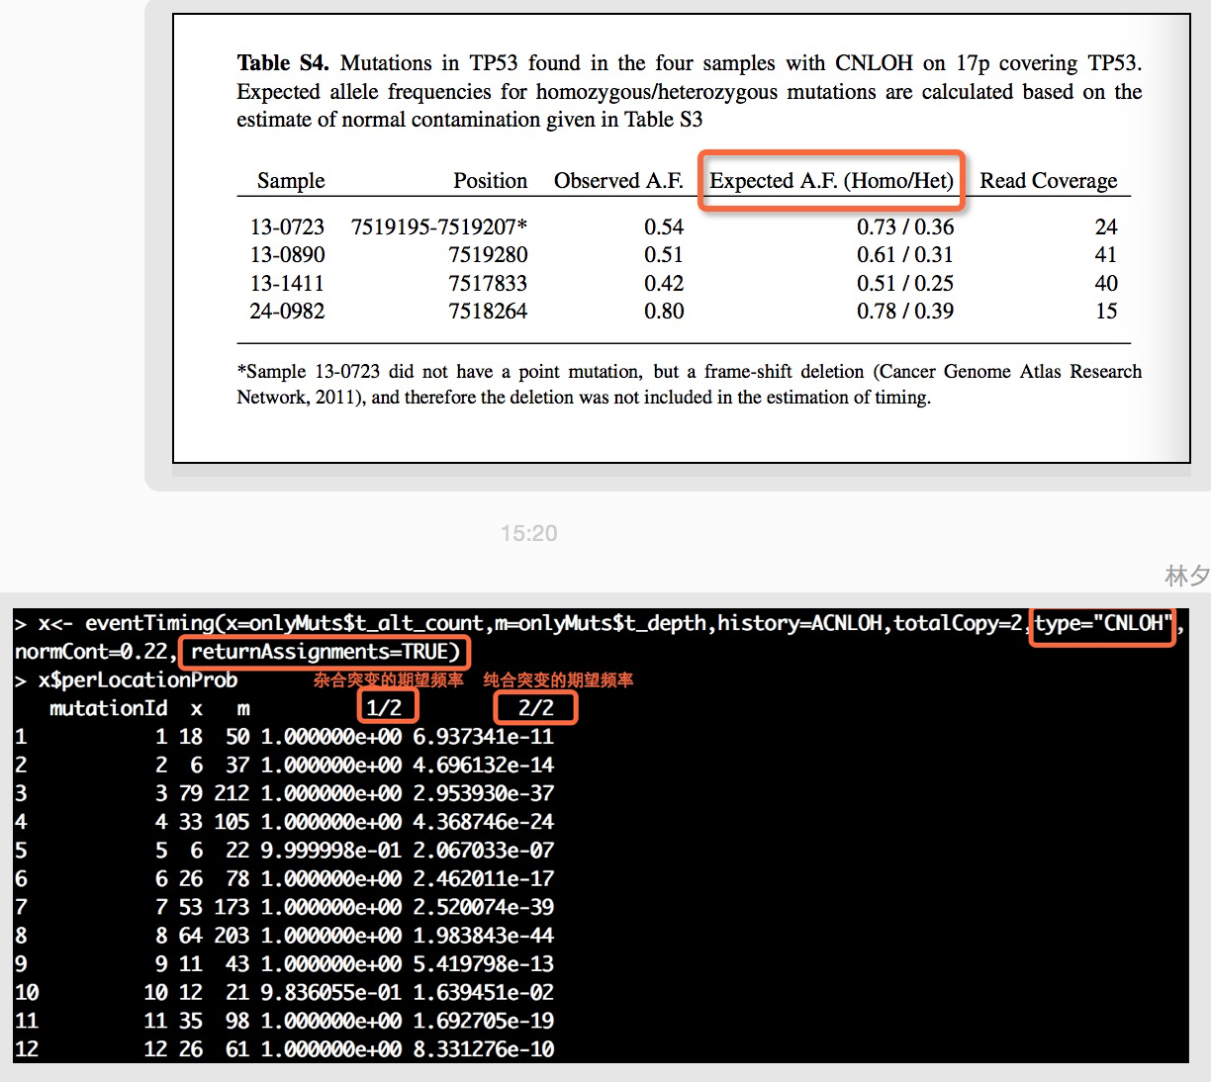
案例
Notes:
cancerTiming（eventTiming函数）只有输出每个位点的q，不支持每个突变位点的 π 的计算。CNLOH区域TP53突变发生在π 0还是π 1，可以根据TP53位点是纯合突变还是杂合突变进行推断，如果是纯合突变（即等位频率为2/2，理论上q(2/2)比较大），可以推断TP53突变发生在π 0阶段，如果是杂合突变（即等位频率为1/2，理论上q(1/2)比较大），可以推断TP53突变发生在π 1阶段。

Slide 12
函数使用方法
（一）makeEventHistory Create the event history matrix
Description
Create the event history matrix needed for the event timing algorithm
代码：
makeEventHistory(type="gain",totalCopy=8)
makeEventHistory(type="gain",copies=c(1,4),totalCopy=5,onlyIdentifiable=FALSE)
# LOH is only an option for totalCopy <3. S=2 type为LOH
makeEventHistory(type="LOH",totalCopy=2,onlyIdentifiable=FALSE)
$`1MLineage`
[,1] [,2]
[1,] 0 2
[2,] 1 0
# Cannot have 'gain' and totalCopy<3. S>2 type为gain
makeEventHistory(type="gain",totalCopy=3,onlyIdentifiable=FALSE)
$`1MLineage`
[,1] [,2]
[1,] 1 3
[2,] 1 0
/PUBLIC/software/CANCER/Software/cancerTiming/work.sh

Slide 13
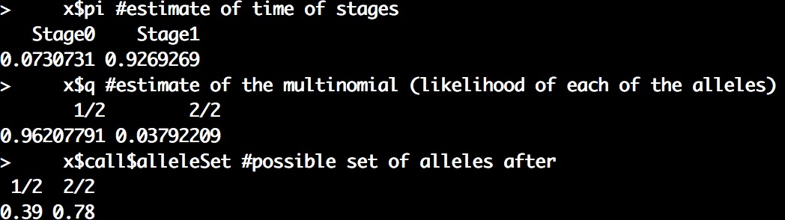
函数使用方法
（二）eventTiming Estimate the time of events in tumor data
Estimate the proportion of time spent between different chromosomal abnormalities based on the allele frequencies of mutated locations.
代码：
data(mutData)
CNLOH <- matrix(c(0,2,1,0),ncol=2,nrow=2,byrow=TRUE)
onlyMuts <- subset(mutData,is.na(rsID) & position <= 1.8E7)
onlyMuts$t_depth <- onlyMuts$t_ref_count+onlyMuts$t_alt_count
x<- eventTiming(x=onlyMuts$t_alt_count,m=onlyMuts$t_depth,
history=CNLOH,totalCopy=2,type="CNLOH",normCont=0.22, returnAssignments=TRUE)
x$pi #estimate of time of stages
x$q #estimate of the multinomial (likelihood of each of the alleles)
x$call$alleleSet #possible set of alleles after adjusting for normal contamination
/PUBLIC/software/CANCER/Software/cancerTiming/work.sh

Slide 14
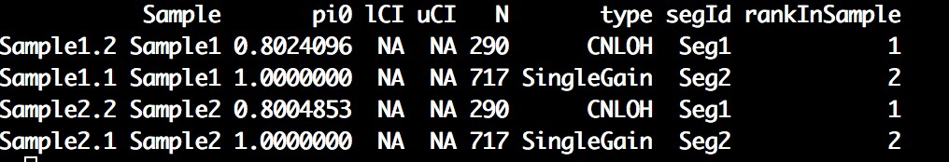
函数使用方法
（三）eventTimingOverList eventTiming for multiple samples and regions
eventTimingOverList is a wrapper to eventTiming that allows for timing of common events over several regions of a sample and/or multiple samples. getPi0Summary gets summary information about ⇡0 (the first event) from the output of that function and returns a simple dataframe of the estimate of ⇡0 for every region and sample combination.
if(require(GenomicRanges)){
#fix up mutation data to right format
data(mutData)
colnames(mutData)[1]<-c("chr")
colnames(mutData)[grep("t_alt_count",colnames(mutData))]<-"nMutAllele"
colnames(mutData)[grep("t_ref_count",colnames(mutData))]<-"nRefAllele"
mutData$nReads<-mutData$nMutAllele+mutData$nRefAllele
mutData$mutationId<-1:nrow(mutData)
#add segmentation annotation -- second region is bogus, only for illustration
segs<-data.frame(chr=c(17,17),start=c(1,1.8e7+100),end=c(1.8e7,81195210),
normCont=0.22,segId=c("Seg1","Seg2"),type=c("CNLOH","SingleGain"))
##Create Trivial segmentation annotation for example
mutId<-mut2Seg(mutData,segs)
eventOut<-eventTimingOverList(dfList=list(Sample1=mutId,Sample2=mutId),normCont=c(0.22,0.20)) getPi0Summary(eventOut)
}

Slide 15


